Slide 1
BA Customer Behaviour Analysis:
Identifying Customers That Are Likely To Complete A Holiday Booking Or Not

Slide 2

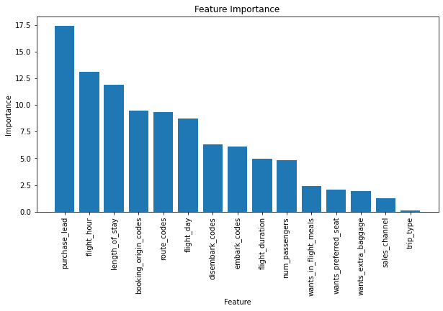
Results
Important Predictive features:
The most important features for predictive purposes were: 'purchase_lead', 'flight_hour', 'length_of_stay', 'booking_origin_codes', 'route_codes', 'flight_day',airport they boarded and disembarked were the most predictive features holding about 80% of predictive information.
Metrics
The accuracy score is pretty high (~85%). However, the F1 score shows the model perform well predicting class 0 and terribly at class 1. This could have been due to the imbalance in the data available as only ~15% of the data represents class 1
Accuracy:
85%
F1 Score:
92% (class 1)
&
18% (class 0)

